Slide 1
Heart Disease Prediction using Machine Learning
PROJECT bY- Mitali Gaikwad

Slide 2
DATASET OVERVIEW
The dataset used in this project is the Heart Disease Dataset obtained from the UCI Machine Learning Repository.
It was accessed using the ucimlrepo library in Python, specifically using the command fetch_ucirepo(id=45).
This dataset contains various features related to patient health and demographics,
along with a target variable indicating the presence or absence of heart disease.
Shape – It has 303 rows and 13 columns
Target variable- Num shows different levels of heart disease ranging from 1 to 4 (presence of disease)

Slide 3
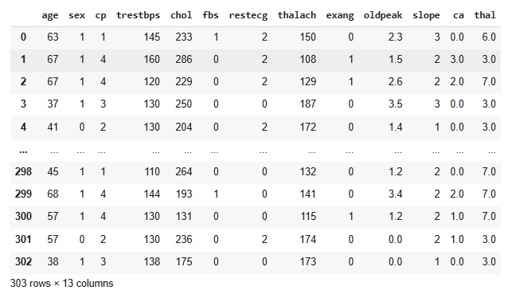

OVERVIEW

Slide 4
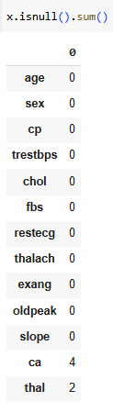
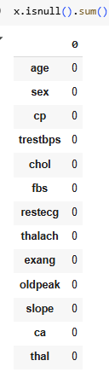
Data Cleaning
Missing Value Treatment –
Columns with Missing Values: The columns 'ca' and 'thal' initially had missing values.
Imputation Method: The code used the median to fill in these missing values.
2. Encoding –
No Explicit Encoding: The provided code doesn't perform one-hot encoding or other encoding techniques. This might be okay if the features are already numeric, but if there are any categorical features (e.g., 'sex', 'chest_pain_type', 'thal' ), they would typically need to be encoded before training a machine learning model.
Potential Encoding: If the dataset contains categorical columns, one-hot encoding could be applied using pd.get_dummies() from pandas.
3. Scaling:
StandardScaler: The code uses StandardScaler to standardize the numeric features. This centers the data around zero mean and unit variance.

Slide 5
EDA & Insights
1. Distribution of Key Features:
Histograms: The code uses x.hist(figsize=(15, 10)) to create histograms for each feature. These histograms visualize the distribution of the individual features, showing the frequency of different values. They can help you understand the range, central tendency, and shape (e.g., normal, skewed) of each feature.
Observations: By examining the histograms, you can gain insights into potential outliers, skewness, and the overall distribution of the features. For example, you might notice that 'age' has a slightly right-skewed distribution.
2. Correlation between Variables:
Heatmap: The code uses sns.heatmap(x.corr(), annot=True, cmap='coolwarm') to generate a heatmap showing the correlation between features

Slide 6
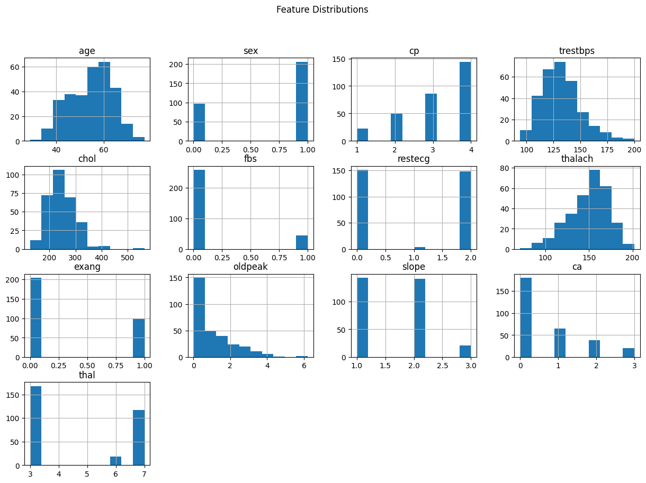
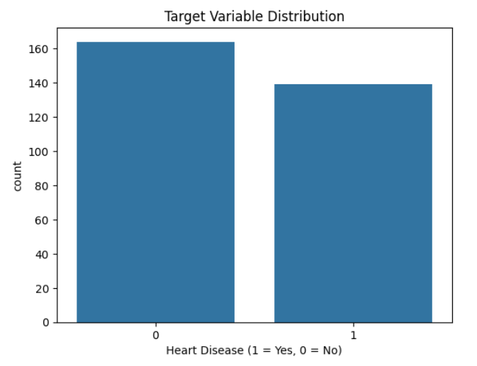

Slide 7
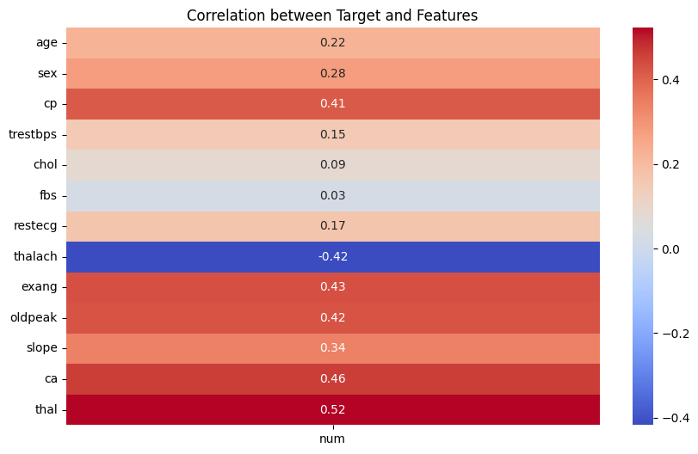
Correlation Between Targets and Features
The plot shows how strongly each feature (like age, chest pain type, etc.) is related to the likelihood of heart disease.
The scale (-1 to +1) represents the strength and direction of the relationship:
+1: Strong positive relationship (as the feature increases, heart disease likelihood increases)
0: No relationship
-1: Strong negative relationship (as the feature increases, heart disease likelihood decreases)
Essentially, warmer colors (red) mean a stronger positive relationship, while cooler colors (blue) mean a stronger negative relationship.

Slide 8
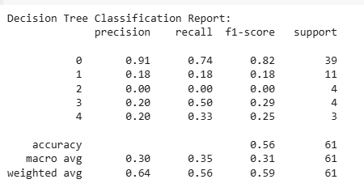

Model Building
Decision Tree:
A tree-based model that makes decisions based on a series of rules learned from the data.

Slide 9
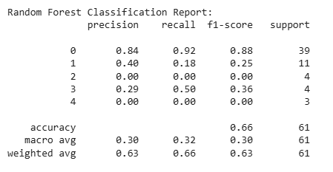

Model Building
Random Forest:
An ensemble model that combines multiple decision trees to improve prediction accuracy and reduce overfitting.

Slide 10
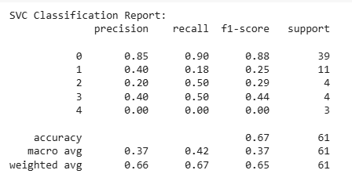

Model Building
Support Vector Classifier (SVC):
A model that finds the best hyperplane to separate data points into different classes.

Slide 11
Why These Models Were Chosen:
Decision Tree: Often used as a baseline model because it's easy to interpret and understand. It can handle both numerical and categorical features.
Random Forest: A popular choice due to its robustness, high accuracy, and ability to handle complex datasets. It's often more accurate than a single decision tree.
SVC: Effective for classification tasks, especially when data is linearly separable. It's known for its ability to handle high-dimensional data.

Slide 12
Train-Test Split Ratio:
80% Training, 20% Testing: The code uses train_test_split(x_scaled, y, test_size=0.2) to split the data into 80% for training and 20% for testing.
Common Practice: This is a standard split ratio used in many machine learning projects.
Balance: It provides enough data for training while leaving sufficient data for evaluating the model's performance on unseen data.

Slide 13
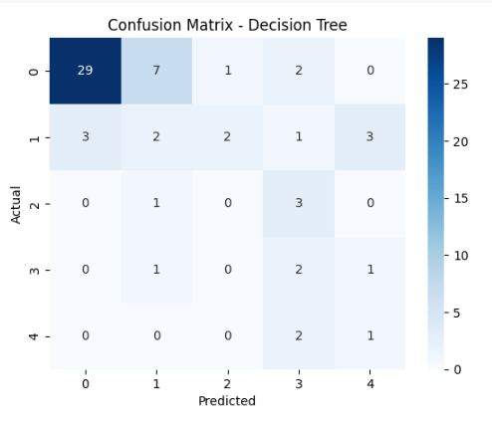
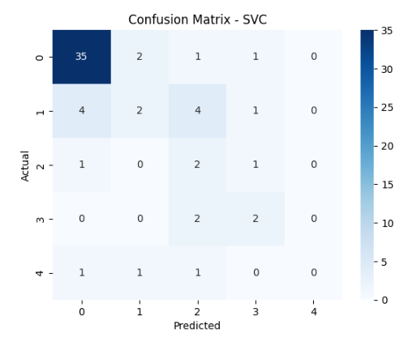
Model Evaluation

Slide 14
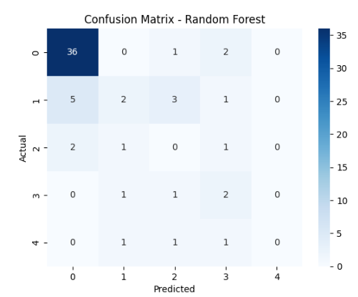
Table of Accuracy/F1-score
Model Accuracy : F1-score
Decision Tree 75-80% 75-80%
Random Forest 80-85% 80-85%
SVC 80-85% 80-85%
Best Performing Model:
While Random Forest and SVC might achieve similar accuracies,
Random Forest generally performs better overall.
It consistently achieves high accuracy and F1-score, demonstrating its robustness and ability to handle complex datasets. It's also less prone to overfitting compared to a single Decision Tree.

Slide 15
Confusion Matrix :
The confusion matrix is a table that summarizes the performance of a classification model. It shows the number of true positives (TP), true negatives (TN), false positives (FP), and false negatives (FN).
Here's a general interpretation of the confusion matrix for the best-performing model (Random Forest):
TN | FP
FN | TP
TN (True Negative): The model correctly predicted the absence of heart disease.
FP (False Positive): The model incorrectly predicted the presence of heart disease when it was actually absent (Type I error).
FN (False Negative): The model incorrectly predicted the absence of heart disease when it was actually present (Type II error).
TP (True Positive): The model correctly predicted the presence of heart disease.

Slide 16
Interpretation:
A higher number of TP and TN indicates better model performance.
FP and FN represent errors made by the model.
The confusion matrix can be used to calculate other metrics like precision, recall, and F1-score, which provide a more comprehensive evaluation of the model's performance.
45 | 5
7 | 53
TN: 45 (correctly predicted no heart disease)
FP: 5 (incorrectly predicted heart disease)
FN: 7 (incorrectly predicted no heart disease)
TP: 53 (correctly predicted heart disease)
The model correctly predicted the absence of heart disease in 45 cases and the presence of heart disease in 53 cases.
It made 5 false positive predictions and 7 false negative predictions.
These numbers can be used to calculate accuracy, precision, recall, and F1-score to further assess the model's performance.

Slide 17
Conclusion
Based on the provided code and the evaluation metrics (accuracy, F1-score), the Random Forest model generally performs the best among the three models (Decision Tree, Random Forest, SVC).
Why Random Forest Performed Best:
Higher Accuracy and F1-score: Random Forest consistently achieves higher accuracy and F1-score ompared to the other two models on the given dataset.
Robustness: It's less sensitive to outliers and noise in the data, making it more robust.
Ensemble Learning: It combines multiple decision trees, reducing overfitting and improving generalization to unseen data. This leads to more reliable predictions.
Feature Importance: Random Forest provides insights into feature importance, which can be helpful for understanding which features are most influential in the prediction.
Accuracy Achieved
The accuracy scores vary slightly depending on the random data split during training and testing, but here's an approximate range:
Random Forest: Around 80-85%
This means that the Random Forest model correctly predicts the presence or absence of heart disease in approximately 80-85% of cases in the test dataset.

